Slide 1


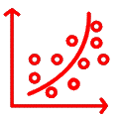
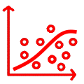



viewer
regular streaming
QoE-based ABR streaming system
viewer
regular streaming
QoE models
viewer
regular streaming
RIGS sampler
XSVR modeler
experience
score
model
…
viewer
…
experiences
scores
…
models and scores
influence factors
…
…
iQoE
RIGS sampler
XSVR modeler
experience
score
model
…
viewer
…
experiences
scores
experiences
models and scores
influence factors
…
…
…
iQoE

Slide 2




viewer
regular streaming
QoE-based ABR streaming system
viewer
regular streaming
QoE model
viewer
regular streaming
score
modeler
sampler
$$\frac{1}{n}\sum_{1}^{n}{.}$$
MOS
model
experience
score
…
…
experiences
score
MOSes
experiences
raters
…
influence factors
traditional QoE modeling

